Slide 1
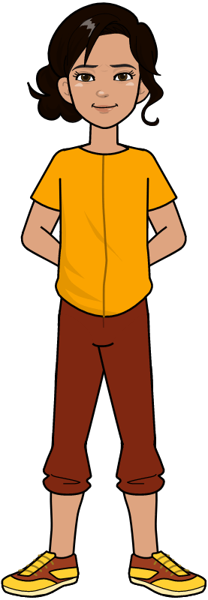
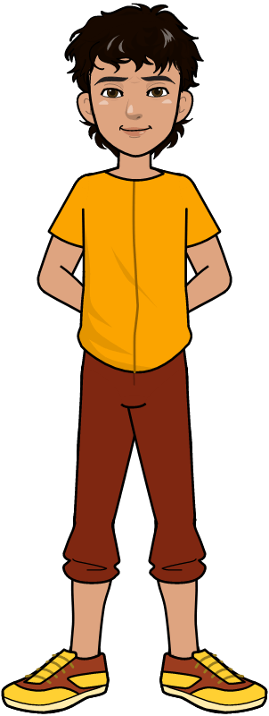
Introduction to Computers and Python

Slide 2
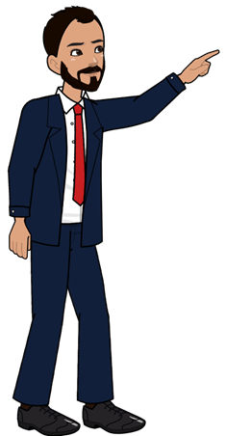
Learning Objectives
Define computers and its major components
Define input, processing, and output concepts in computing
Define and understand the need of programming languages
Explain the advantages of Python programming language
Computer Science Department, UET Lahore.

Slide 3

Why do we need Computers? (Why)
We need computers to perform different daily routine tasks.
The ability of the computer to store, retrieve, and process data in seconds makes is desirable to every person.
If only I had a machine, to solve my problems
Computer Science Department, UET Lahore.

Slide 4
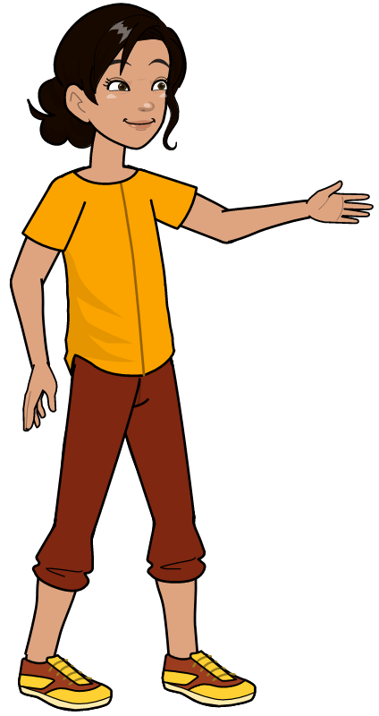
Operations Using Computers
We can perform various operations by using the computers
Some of these operations include
1. Creating Documents
2. Playing Games
3. Sending Emails and Messages
4. Browsing Web
5. Creating and Editing Videos
6. Solve mathematical problems
Computer Science Department, UET Lahore.

Slide 5
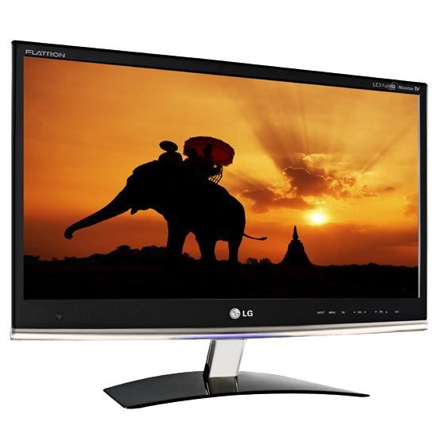
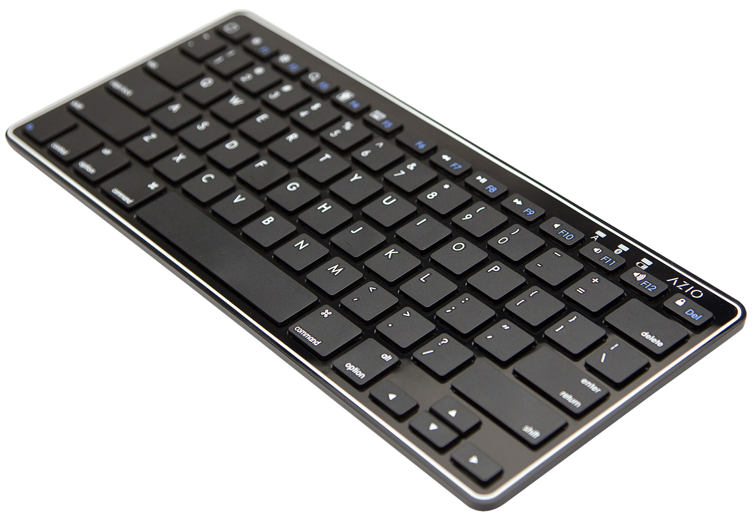
Computer is a Machine
Computer is a Machine that takes Input, processes on it and gives Output.
Computer
Input
Output
Computer Science Department, UET Lahore.

Slide 6
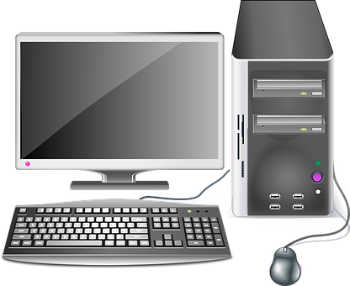

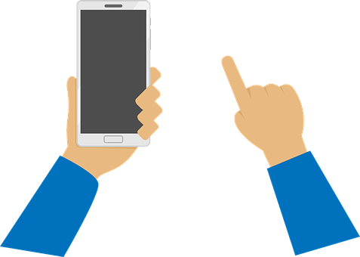
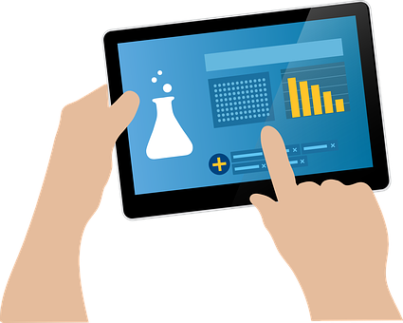
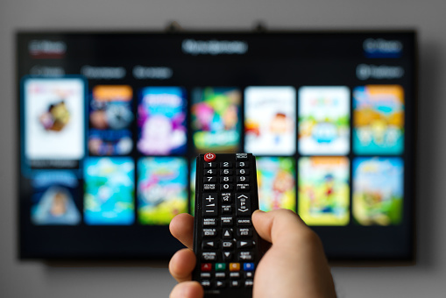
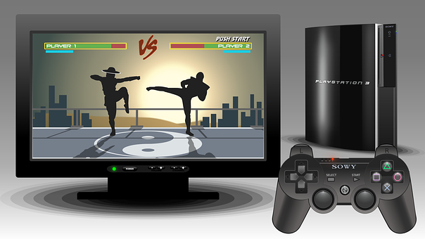
Computing Devices
There are different kinds of Computers.
Desktop Computers
Laptops
Tablets
Smart Phones
Smart TVs
Game Consoles
Computer Science Department, UET Lahore.

Slide 7
Activity
1. Computer is also a machine !
2. What makes it different from other machines?
Computer Science Department, UET Lahore.
Notes:
Answer: A Computer is a Programmable machine that can be programmed to perform different tasks.

Slide 8
What is inside the Computer?
Computer
Hardware
Is combination of
Software
Computer Science Department, UET Lahore.

Slide 9
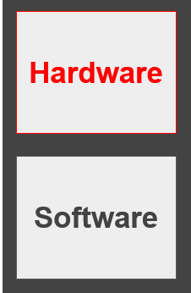
Hardware
Hardware are the physical components of the computer. The examples include
1. CPU
2. Input/Output Devices
3. Storage Devices
Computer Science Department, UET Lahore.

Slide 10
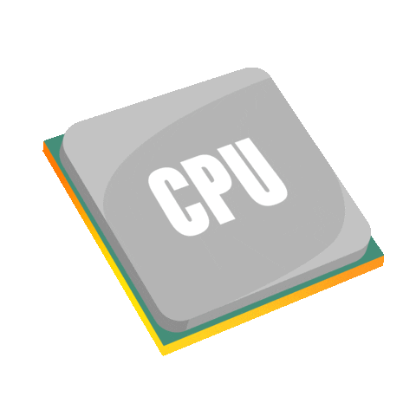
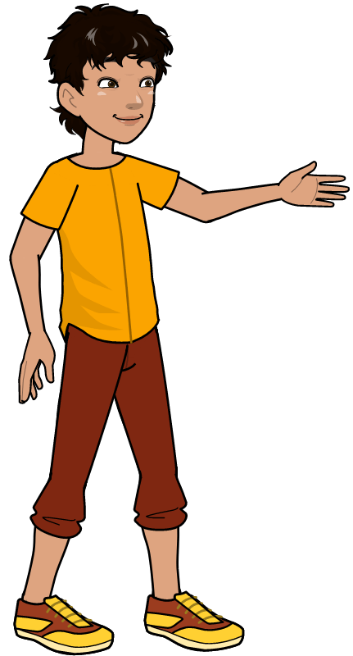
CPU: Brain of the Computer
CPU is the main processing unit
It is the brain of the computer that
performs all the processing
Computer Science Department, UET Lahore.

Slide 11
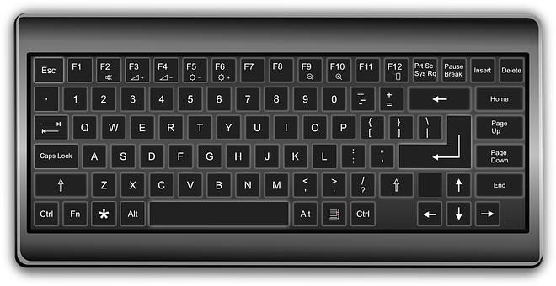


Input/Output Devices
Input Devices are used to give input to the computer. The examples include
Keyboard
Mouse
Microphone
Computer Science Department, UET Lahore.

Slide 12
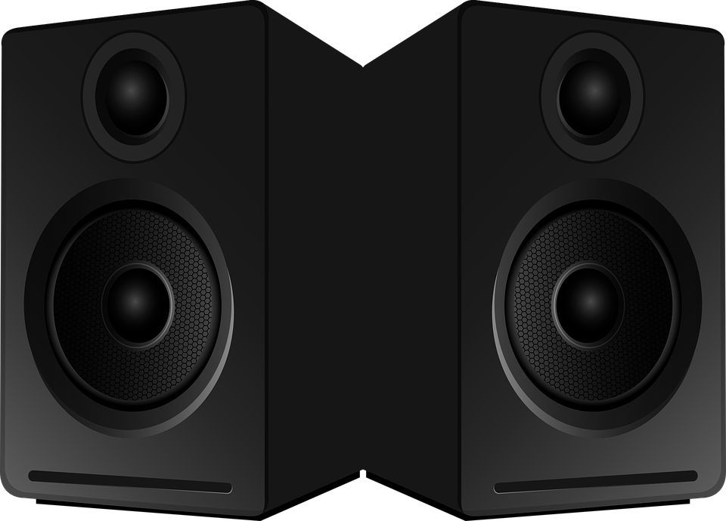

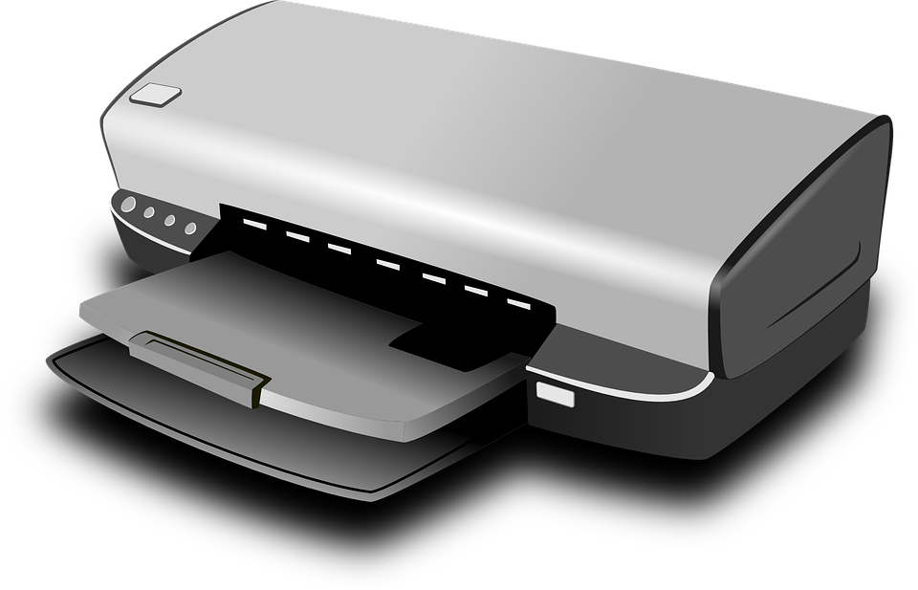
Input/Output Devices
Output Devices are used to get output from the computer. The examples include
Monitor/LCD
Printer
Speakers
Computer Science Department, UET Lahore.

Slide 13
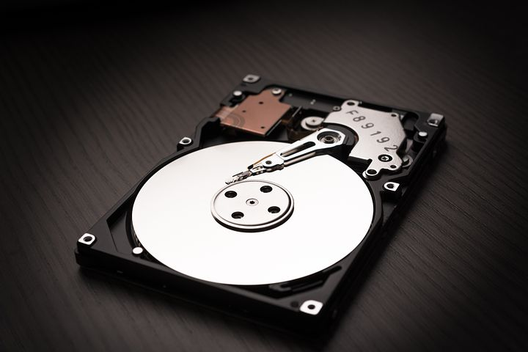

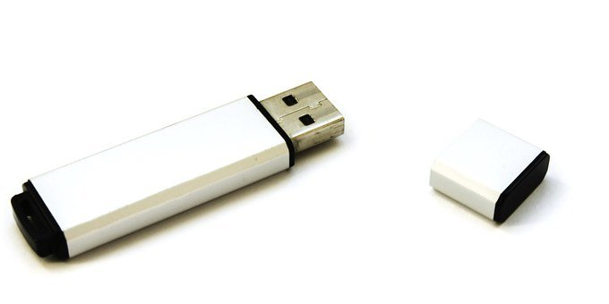
Storage Devices
Storage Devices are used to store the processed data into the computer. The examples include
Hard Disks
CDs
Flashdrives
Computer Science Department, UET Lahore.

Slide 14
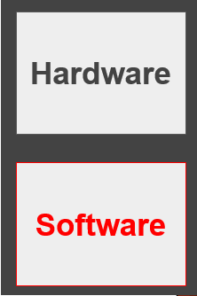





Software
Software are Intangible components of the computer. The examples include
1. Operating System
2. Application softwares
Computer Science Department, UET Lahore.

Slide 15
Operating System
Operating system is software that is required in order to run application programs and utilities.
It works as a bridge to perform better interaction between application programs and hardware of the computer.
Computer Science Department, UET Lahore.

Slide 16
Operating System
It manages computer hardware, software resources, and provides common services for computer programs.
Application and System Software
Operating System
Hardware
Computer Science Department, UET Lahore.

Slide 17

Operating System
Application Software
Operating System
Hardware
Computer Science Department, UET Lahore.

Slide 18


Application Programs
Application Program is a type of computer software that performs a specific function to solve a user problem. The examples include
Web Browsers
Word Processors
Media Players
Computer Science Department, UET Lahore.

Slide 19
Activity
1. Identify different components in the human body as hardware and software.
Computer Science Department, UET Lahore.
Notes:
Physical Body is the hardware. Tangible Components. Hand, Ears, Nose,
Input: Nose, Eyes, Ears etc.
Output: Mouth
Software: Mind, Soul (Rooh)
CPU: Brain

Slide 20
What is Data Science ?
Field of applying tools and techniques on data to extract valuable information
This information is used for
Decision-Making
Stronger Marketing Campaigns
Computer Science Department, UET Lahore.

Slide 21

Applications of Data Science
The internet and world wide web are the applications of the data science that are most commonly used by people.
Computer Science Department, UET Lahore.

Slide 22
Need of Programming Languages
The programming language is a type of language that we use to tell computer to perform a task.
The computers only understand binary language that consist of 0s and 1s.
Meanwhile, we humans, only understand languages such as Urdu or English.
Therefore, we need to use some programming language to tell the computer to perform a task.
Computer Science Department, UET Lahore.

Slide 23
Consider this…
Think of this as two persons communicating with each other ?
Where first person speaks Chinese and the second person speaks Urdu.
Imagine the communication between the two persons ! Do you think they can talk with each other?
YES ! BUT we need a TRANSLATOR !
Computer Science Department, UET Lahore.

Slide 24
Complier
That Translator is the Compiler.
It is a coverter that translates the program from one language to other.
Computer Science Department, UET Lahore.

Slide 25
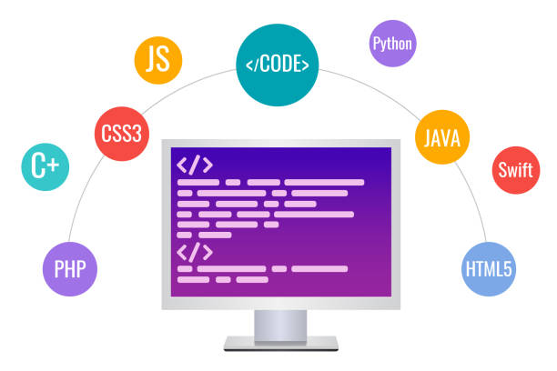
Types of Programming Languages
There are two types of programming languages.
High-Level Languages
Low-Level Languages
Computer Science Department, UET Lahore.
Notes:
The Middle-level language is a type of language that lies between high-level and low-level languages.

Slide 26
High Level Languages
The High-level language is a type of programming language that is understandable by us humans.
Examples include languages such as C++ and Python
Computer Science Department, UET Lahore.

Slide 27
Low Level Languages
The Low-level language is a type of language that is understandable by computers.
Example includes assembly language and binary language
Computer Science Department, UET Lahore.

Slide 28
Source code vs Object Code
The program written in high level language is called the Source code.
The program written in low level language is called the Object code.
Computer Science Department, UET Lahore.

Slide 29
Activity
Why do you think that we needed to develop the High-Level Languages when we had the Low-Level Languages ?
Computer Science Department, UET Lahore.
Notes:
Answer: We need the high level languages due to the fact that low-level-languages are very close to machine language (0,1 Binary lang.) that is difficult for us humans to remember.

Slide 30

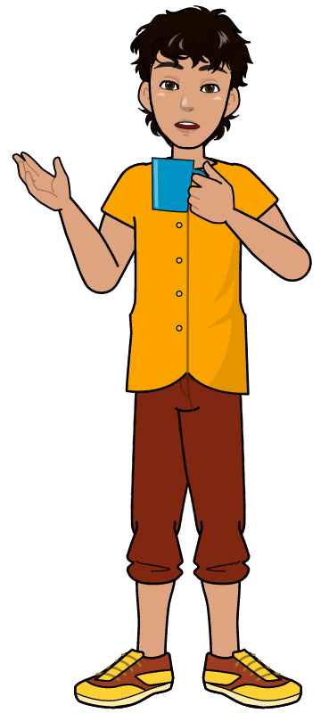
Background of Python Language
Invented in Netherlands in early 90s
Guido Van Rossum is its inventor
Open Source from day one
It has been adopted worldwide
The number of users increased rapidly
Popularity left behind top programming languages such as Java and C++
Computer Science Department, UET Lahore.
Notes:
The inventor was a fan of the famous show “Monty Python’s Flying Circus” and thus it received the name i.e. Python.

Slide 31
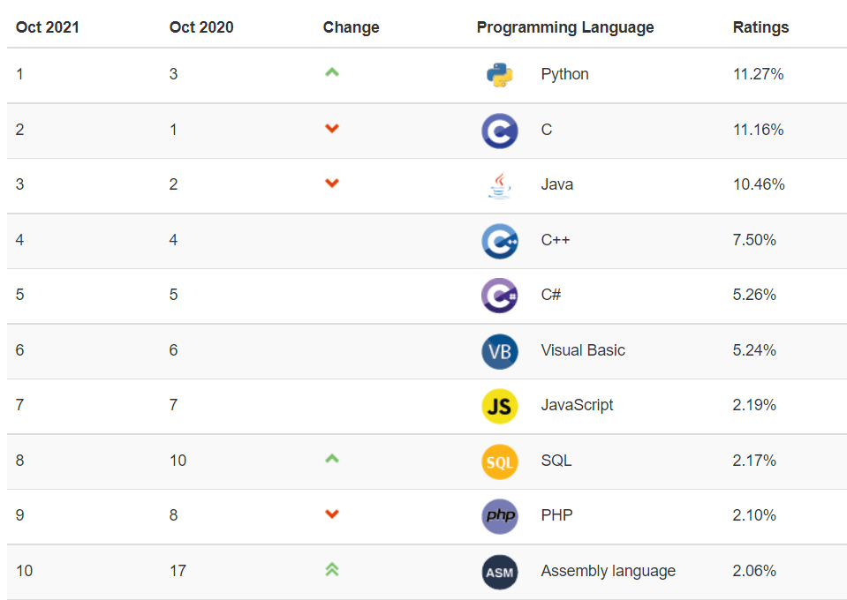
Why learn Python Language
Python is the number 1 programming language in the 2021 ranking of programming languages.
Computer Science Department, UET Lahore.
Notes:
Source: https://www.tiobe.com/tiobe-index/

Slide 32
Applications of Python Language
Artificial Intelligence
Machine Learning
Web based Applications
Scientific Applications
System Administration
Graphical User Interface based Applications
Gaming Applications
Database Programming and much more
Computer Science Department, UET Lahore.
Notes:
Scientific Applications (Weka etc.)
System Administration (Unix, Web-logic)

Slide 33
Features of Python Language
It is a high level programming language.
Open source and community driven
Dynamically Typed
Multi-Purpose (Web, Applications etc.)
Object Oriented Language
Interpreted Language (line by line)
Cross-Platform (Windows, Linux etc.)
Computer Science Department, UET Lahore.

Slide 34
Advantages of Python Language
It is Easy to learn and use
Provides GUI Support
Provides Large Standard Libraries
Easily Integrated
Extendable Language
Fast Debugging (line by line)
Expressive (Understandable & Readable)
Computer Science Department, UET Lahore.

Slide 35

Learning Objective
In this lecture, we learnt about computers and its components, and input, processing, and output. We also defined the need of programming languages, types of programming languages and learned about Python programming language.
Computer Science Department, UET Lahore.

Slide 36
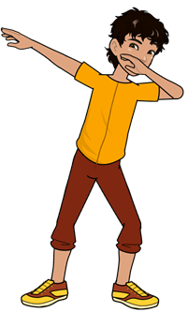
Conclusion
We use computers to solve various problems.
The software and hardware are the major components of the computer.
To program computers to do something, we use programming language.
Python is a high-level programming language that is used to program computer to perform different tasks.
Computer Science Department, UET Lahore.

Slide 37

Take Home Tasks
1. Find out about 5 most popular older programming languages.
2. Find out about 5 most recent popular programming languages.
3. Find out the difference between compilation and execution of a computer program.
4. Find out the difference between compiler and interpreter.
5. Find out five examples of high level and low level languages.
Computer Science Department, UET Lahore.

